Slide 1





Slide 2


A transaction is a unit of program execution that accesses and possibly updates various data items

Slide 3


E.g. transaction to transfer $50 from account A to account B:
1. read(A)
2. A := A – 50
write(A)
read(B)
5. B := B + 50
6. write(B)

Slide 4

Two main issues to deal with:
Failures of various kinds, such as hardware failures and system crashes
Concurrent execution of
multiple transactions

Slide 5


A Atomicity
C Consistency
To preserve the integrity of data the database system must ensure ACID properties
I Isolation
D Durability

Slide 6


Atomicity. Either all operations of the transaction are properly reflected in the database or none are.
Consistency. Execution of a transaction in isolation preserves the consistency of the database.

Slide 7


Isolation. Although multiple transactions may execute concurrently, each transaction must be unaware of other concurrently executing transactions.
Intermediate transaction results must be hidden from other concurrently executed transactions.
That is, for every pair of transactions T_{i} and T_{j}, it appears to T_{i} that either T_{j}, finished execution before T_{i} started, or T_{j} started execution after T_{i} finished.

Slide 8


Durability. After a transaction completes successfully, the changes it has made to the database persist, even if there are system failures.

Slide 9
Example of Fund Transfer
Transaction to transfer $50 from account A to account B:
1. read(A)
2. A := A – 50
write(A)
read(B)
5. B := B + 50
6. write(B)
Atomicity requirement
if the transaction fails after step 3 and before step 6,
money will be “lost” leading to an inconsistent database
state .
Failure could be due to software or hardware
the system should ensure that updates of a partially
executed transactio^{p}n^{repa}a^{red}r^{b}e^{y Vi}n^{sak}o^{h V}t^{,As}r^{sis}e^{ta}f^{nt}l^{P}e^{ro}c^{fes}t^{so}e^{r,} d in the database
LBSITW

Slide 10

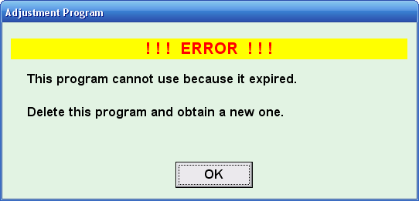
Durability requirement — once the user has been notified that the transaction has completed (i.e., the transfer of the
$50 has taken place), the updates to the database by the transaction must persist even if there are software or hardware failures.

Slide 11
Consistency requirement
the sum of A and B is unchanged by the execution of the transaction
In general, consistency requirements include
Explicitly specified integrity constraints such as
primary keys and foreign keys
Implicit integrity constraints
e.g. sum of balances of all accounts, minus sum of loan amounts must equal value of cash-in-hand
A transaction must see a consistent database.
During transaction execution the database may be temporarily inconsistent.
When the transaction completes successfully the database must be consistent
Erroneous transaction logic can lead to inconsistency

Slide 12
Isolation requirement — if between steps 3 and 6, another transaction T2 is allowed to access the partially updated database, it will see an inconsistent database (the sum A + B will be less than it should be).
T1
1. read(A)
2. A := A – 50
3. write(A)
T2
read(A), read(B), print(A+B)
4. read(B)
5. B := B + 50
6. write(B
Isolation can be ensured trivially by running transactions serially
– that is, one after the other.
However, executing multiple transactions concurrently has significant benefits, as we will see later.

Slide 13
TRANSACTION STATES
Transaction State

Slide 14
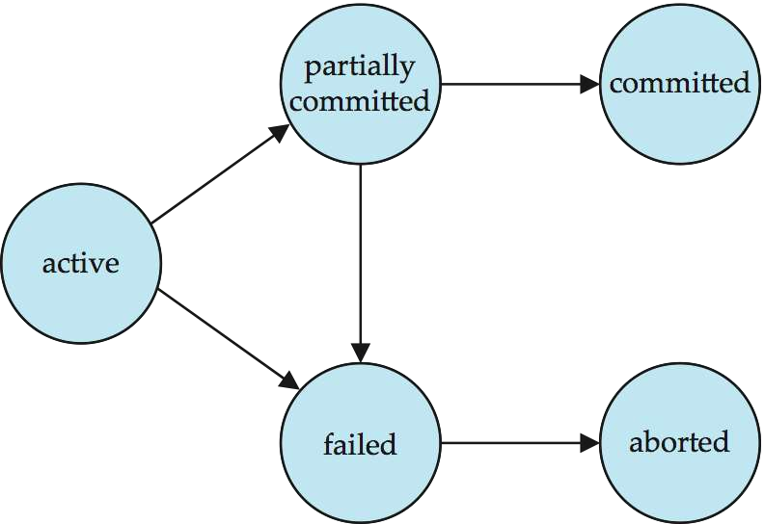

Slide 15
Active – the initial state; the transaction stays in this
state while it is executing
Partially committed – after the final statement has been executed.
Failed -- after the discovery that normal execution can no longer proceed.
Aborted – after the transaction has been rolled back and the database restored to its state prior to the start of the transaction. Two options after it has been aborted:
restart the transaction
can be done only if no internal logical error
kill the transaction
Committed – after successful completion.

Slide 16
Concurrent Executions
Multiple transactions are allowed to run concurrently in the system. Advantages are:
increased processor and disk utilization, leading to better transaction throughput
E.g. one transaction can be using the CPU while another is
reading from or writing to the disk
reduced average response time for transactions: short transactions need not wait behind long ones.
Concurrency control schemes – mechanisms to
achieve isolation
that is, to control the interaction among the concurrent transactions in order to prevent them from destroying the consistency of the database

Slide 17
Schedules
Schedule – a sequences of instructions that specify the order
in which instructions of concurrent transactions are executed
a schedule for a set of transactions must consist of all instructions of those transactions
must preserve the order in which the instructions appear in each
individual transaction.
A transaction that successfully completes its execution will have a commit instructions as the last statement
by default transaction assumed to execute commit instruction as
its last step
A transaction that fails to successfully complete its execution
will have an abort instruction as the last statement

Slide 18
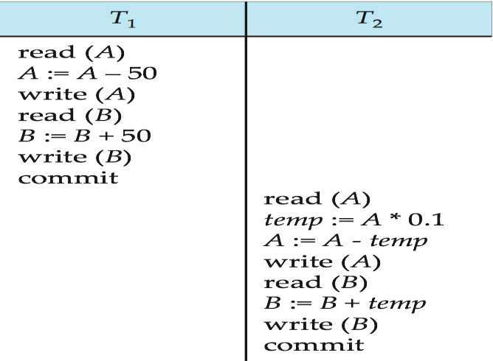
Schedule 1
Let T₁ transfer $50 from A to B, and T₂ transfer 10% of the balance from A to B.
A serial schedule in which T₁ is followed by T₂ :

Slide 19
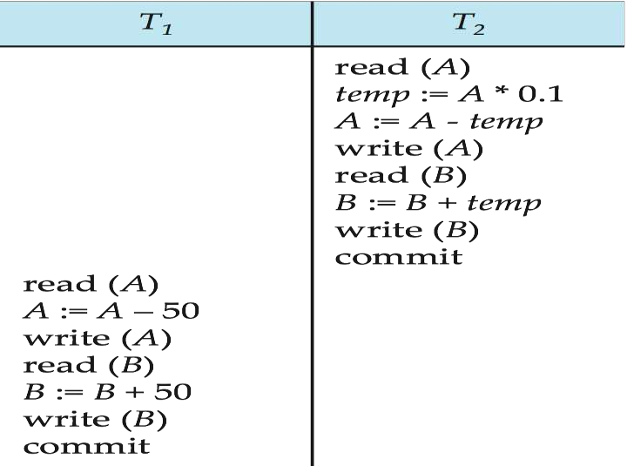
Schedule 2
A serial schedule where T₂ is followed by T₁

Slide 20
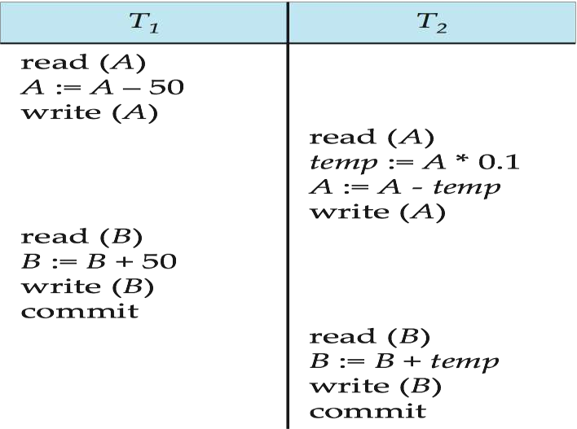
Schedule 3
Let T₁ and T₂ be the transactions defined previously. The following schedule is not a serial schedule, but it is equivalent to Schedule 1.
Concurrent schedule →
In Schedules 1, 2
and 3,
the sum A + B is
preserved.

Slide 21
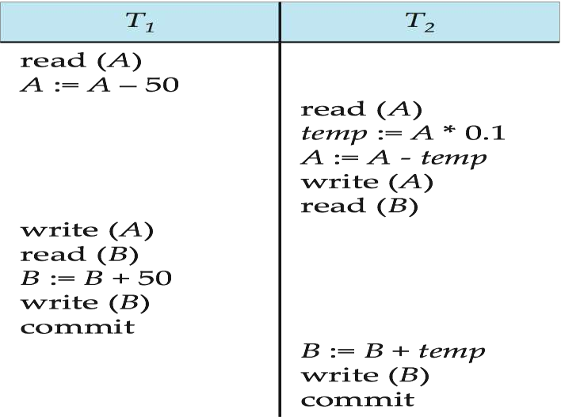
Schedule 4
The following concurrent schedule does not preserve the value of (A + B ).

Slide 22
SERIALIZABILITY OF TRANSACTION

Slide 23







Slide 24




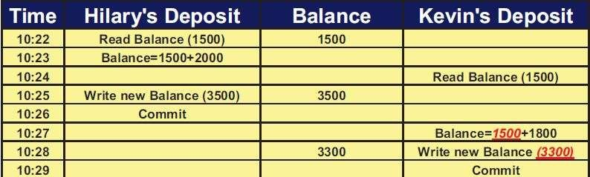
This problem occurred because two transactions are working on the same resource without knowing each other’s activity

Slide 25



: transaction reads values written by another transaction that hasn’t committed yet.
This problem has occurred because two transactions are working on the same resource without knowing
each other’s activity

Slide 26
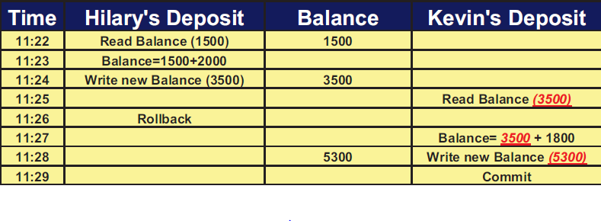

Slide 27


Newly inserted rows appear as phantom to the
transaction
A transaction re-executes a query returning a set of rows that satisfy a search condition and finds that the set of rows satisfying the condition has changed as a result of another recently committed transaction

Slide 28

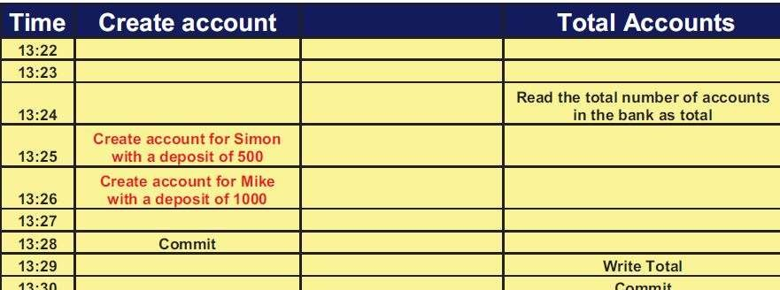

Slide 29




